Slide 1
OLAP
OnLine Analysis Processing

Slide 2
Decision support tools
Data
Mining
Direct
Query
Reporting
tools
OLAP
Essbase
Intelligent Miner
Crystal reports
Merge
Clean
Summarize
Relational
DBMS+
e.g. Redbrick
Data warehouse
Detailed
transactional
data
GIS
data
Census
data
Bombay branch
Delhi branch
Calcutta branch
Oracle
DB2
SAS
Operational data (OLTP)

Slide 3
Knowledge
What would the business like to know …?

Slide 4
Knowledge
Who should I target with holidays brochures?
Who is likely to by a Volvo Cross Country Wagon?
We have had lots of sales recently – I’d like to know actual sales, actual revenue and see the percentage increase on last year.

Slide 5
Data- Consider a supermarket
What data do they have ?

Slide 6
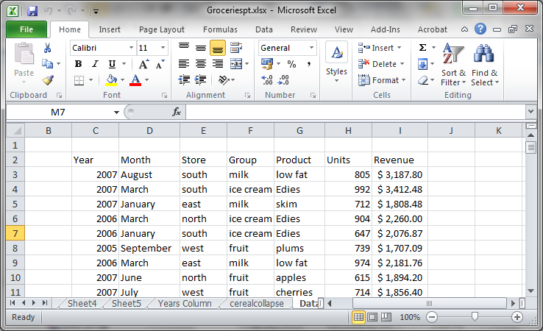
Data- Consider a supermarket
What data do they have ?

Slide 7
Data- Consider a supermarket
What analysis would be useful for this data?
Amount spent per year in store on each product
Total spend at each store
Total spend at each year
The best selling product
The worst selling product
The amount spent in the Jan-March

Slide 8
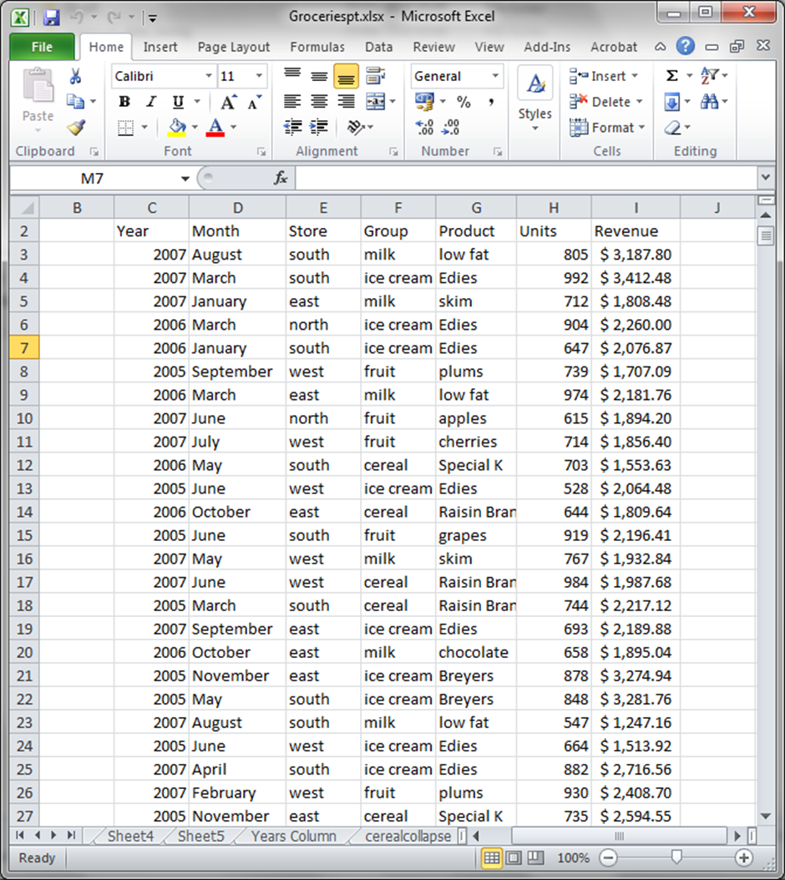

Slide 9
Data- Consider a supermarket
Demo
Using groceries.xlxs

Slide 10
What is OLAP
https://www.youtube.com/watch?v=2ryG3Jy6eIY

Slide 11
Your turn to think
What would be useful to analyse for the case study …
Totals, Averages, Percentages, Max, Min, calculation.
Per year, Per month, per product/customer/???

Slide 12
What is OLAP
Online Analysis…
Could be in a relational database, spreadsheet, DW – using star schema and dimension tables
Data Mining is similar but more complex – using algorithms to search the data for interesting things and patterns.

Slide 13
OLAP
Fast, interactive answers to large aggregate queries.
Multidimensional model: dimensions with hierarchies
  Dim 1: Bank location:
    branch-->city-->state
  Dim 2: Customer:
    sub profession --> profession
  Dim 3: Time:
    month --> quarter --> year
Measures: loan amount, #transactions, balance

Slide 14
Correlation
Data
Information
Knowledge
Intelligence
Analyse
Apply
Structure

Slide 15
Knowledge
Predictions
Understanding
Links
Business Intelligence
Business Advantage
Refine processes, develop products, target customers, suppliers, prevent problems, foresee situations, plan rather than react, streamline the business.

Slide 16
Example of a large aggregate query
SELECT channel_desc, calendar_month_desc, country_iso_code, TO_CHAR( SUM(amount_sold), '9,999,999,999') SALES$, GROUPING(channel_desc) CH, GROUPING (calendar_month_desc) MO, GROUPING(country_iso_code) CO
FROM sales, customers, times, channels, countries
WHERE sales.time_id=times.time_id
AND sales.cust_id=customers.cust_id
AND customers.country_id = countries.country_id
AND sales.channel_id= channels.channel_id
AND channels.channel_desc IN ('Direct Sales', 'Internet')
AND times.calendar_month_desc IN ('2000-09', '2000-10')
AND country_iso_code IN ('GB', 'US')
GROUP BY CUBE(channel_desc, calendar_month_desc, country_iso_code) HAVING (GROUPING(channel_desc)=1 AND GROUPING(calendar_month_desc)= 1 AND GROUPING(country_iso_code)=1) OR (GROUPING(channel_desc)=1 AND GROUPING (calendar_month_desc)= 1) OR (GROUPING(country_iso_code)=1 AND GROUPING(calendar_month_desc)= 1);
Notes:
http://docs.oracle.com/cd/B28359_01/server.111/b28313/aggreg.htm

Slide 17
Multidimensional Data - OLAP
Sales volume as a function of product, month, and region
Region
Table Dimensions: Product, Location, Time
Hierarchical summarization paths
Industry Region Year
Category Country Quarter
Product City Month Week
Office Day
Product
Month

Slide 18

A Sample Data Cube - OLAP
Date
Total annual sales
of TV in U.S.A.
1Qtr
2Qtr
3Qtr
4Qtr
sum
Product
TV
PC
U.S.A
VCR
sum
Canada
Country
Mexico
sum

Slide 19
Typical OLAP Operations
Roll up (drill-up): summarize data
  by climbing up hierarchy or by dimension reduction
Drill down (roll down): reverse of roll-up
  from higher level summary to lower level summary or detailed data, or introducing new dimensions
Slice and dice:
  project and select
Pivot (rotate):
  reorient the cube, visualization, 3D to series of 2D planes.
Other operations
  drill across: involving (across) more than one fact table
  drill through: through the bottom level of the cube to its back-end relational tables (using SQL)

Slide 20
Characteristics of OLAP
For the reports you identified earlier.
Which are …
  Drill up
  Drill down
  Slice and dice
  Pivot
….?

Slide 21
Impementation
Detail table
Dimension tables

Slide 22
Visualising the data
  Drill up
  Drill down
  Slice and dice
  Pivot
….?

Slide 23
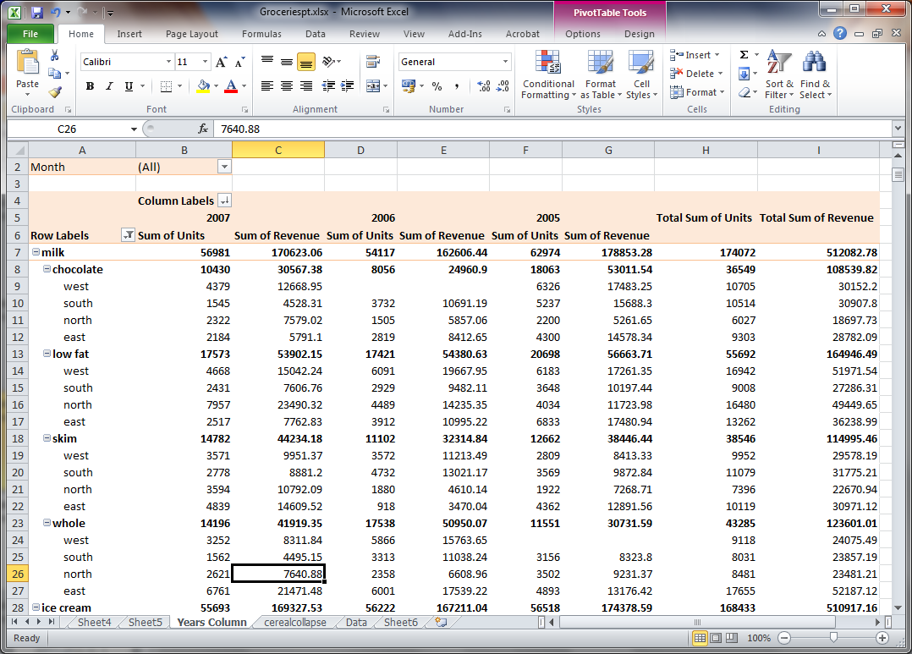

Slide 24
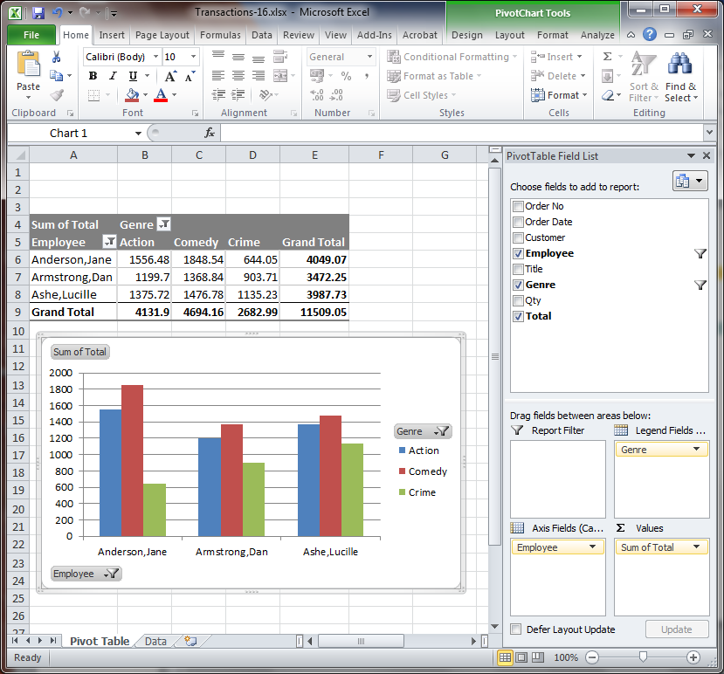

Visualising the data

Slide 25
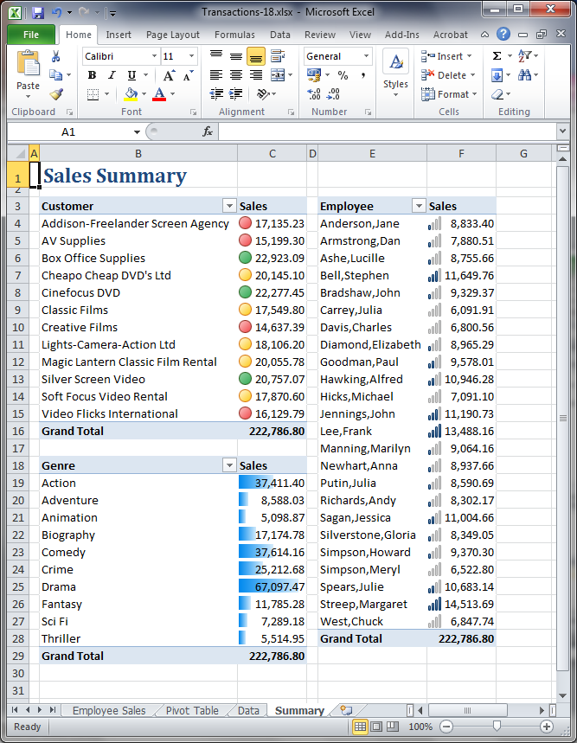

Slide 26
Visualising the data
http://www.informationisbeautiful.net/2010/the-beauty-of-data-visualization/
Powerful
Dashboards, traffic lights
Also can be rubbish!
Lets go back to these and answer questions …

Slide 27
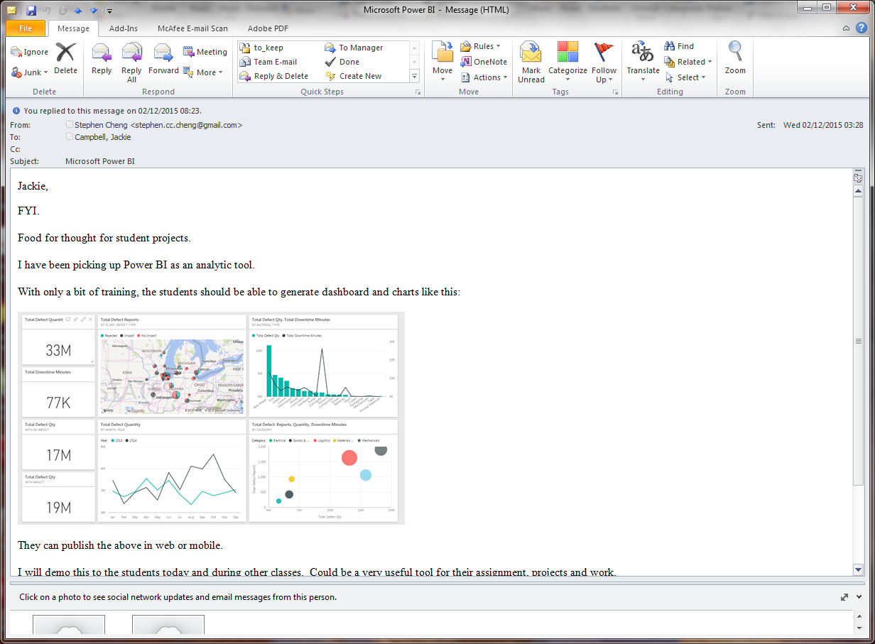
MS Power BI

Slide 28
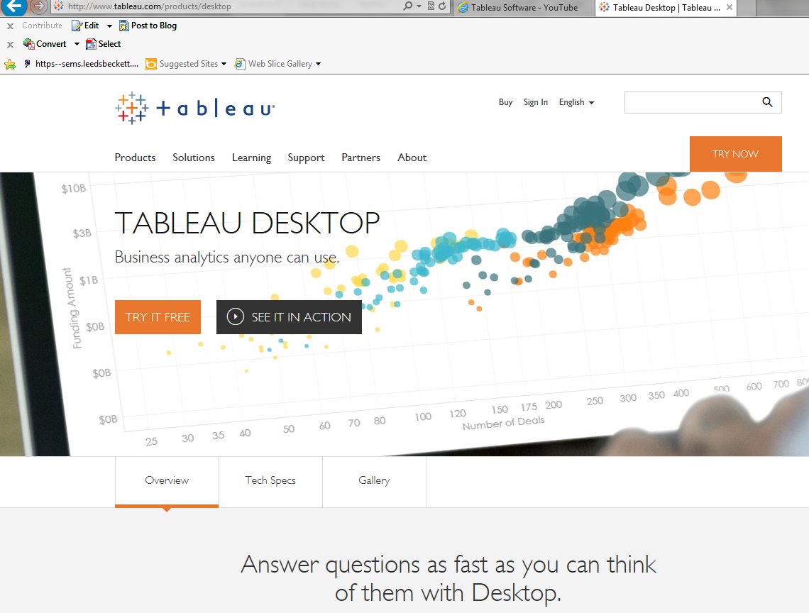
Tableau
https://www.youtube.com/user/tableausoftware/videos
http://www.tableau.com/products#video

Slide 29
Recap
OLAP
Pivot tables
Data visualisation
https://www.youtube.com/watch?v=2ryG3Jy6eIY

Slide 30
Tutorial
OLAP
Extra: Session 5 of Excel 2010 Expert skills book
Tableau

